Slide 1



Bombardier Engineering System
Irving Alvarado (x. 55138)
Level 0, Oct-2020

Slide 2









BES Description
BES describes how we define, develop, certify, validate, and maintain commercial aerospace products.
BES is Bombardier’s Product Development System

Slide 3






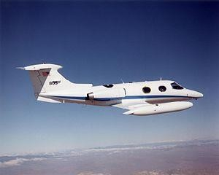

BES History
Executive Vice-President Engineering and Product Development
launched BES in 1995 after the acquisition of 4 aerospace companies:
Canadair (1986)
Shorts Brothers (1989)
Learjet (1990)
DeHavilland (1992)
Mandate to harmonize the four sites’ engineering systems into one common system to reflect best practices
Canadair Challenger (CL-600)
Shorts 360
Learjet 24
De Havilland Beaver DHC-2

Slide 4
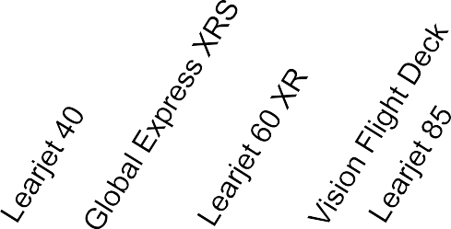





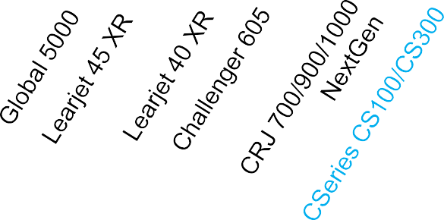

BOMBARDIER AEROSPACE’S HISTORY OF INNOVATION
AN IMPRESSIVE JOURNEY: 31 AIRCRAFT PROGRAMS SINCE 24 YEARS*
There is a lot knowledge and lessons learned captured From Bombardier’s experience within BES
⇧    
⇧
⇧
⇧
⇧
⇧
⇧
⇧ 
⇧
1989 1990
1991 1992 1993
1994 1995 1996 1997 1998 1999 2000
2001 2002 2003 2004 2005 2006
2007 2008
2009 2010 2011 2012 2013
⇧
⇧
⇧
⇧
⇧ 
⇧ 
⇧
⇧
⇧ 
* Note: These are Launch dates

Slide 5
Today’s Challenges for Bombardier ?
Competitive business environment
Customer needs and expectations constantly evolve to reduce price, improve quality, and deliver quicker than previous aircraft programs
Today’s global economy demands the ability to plan, design, manufacture, deliver and maintain products from a diverse workforce
Programs with multiple sites, multiple business units, and external partner
involvement
Need to maintain a consistent level of engineering excellence with a uniform methodology of our products
Need to demonstrate business processes control
Compliance to the Aerospace International Quality Standards
Solid working relationship with certification authorities
Increased delegation by the authorities to Bombardier

Slide 6
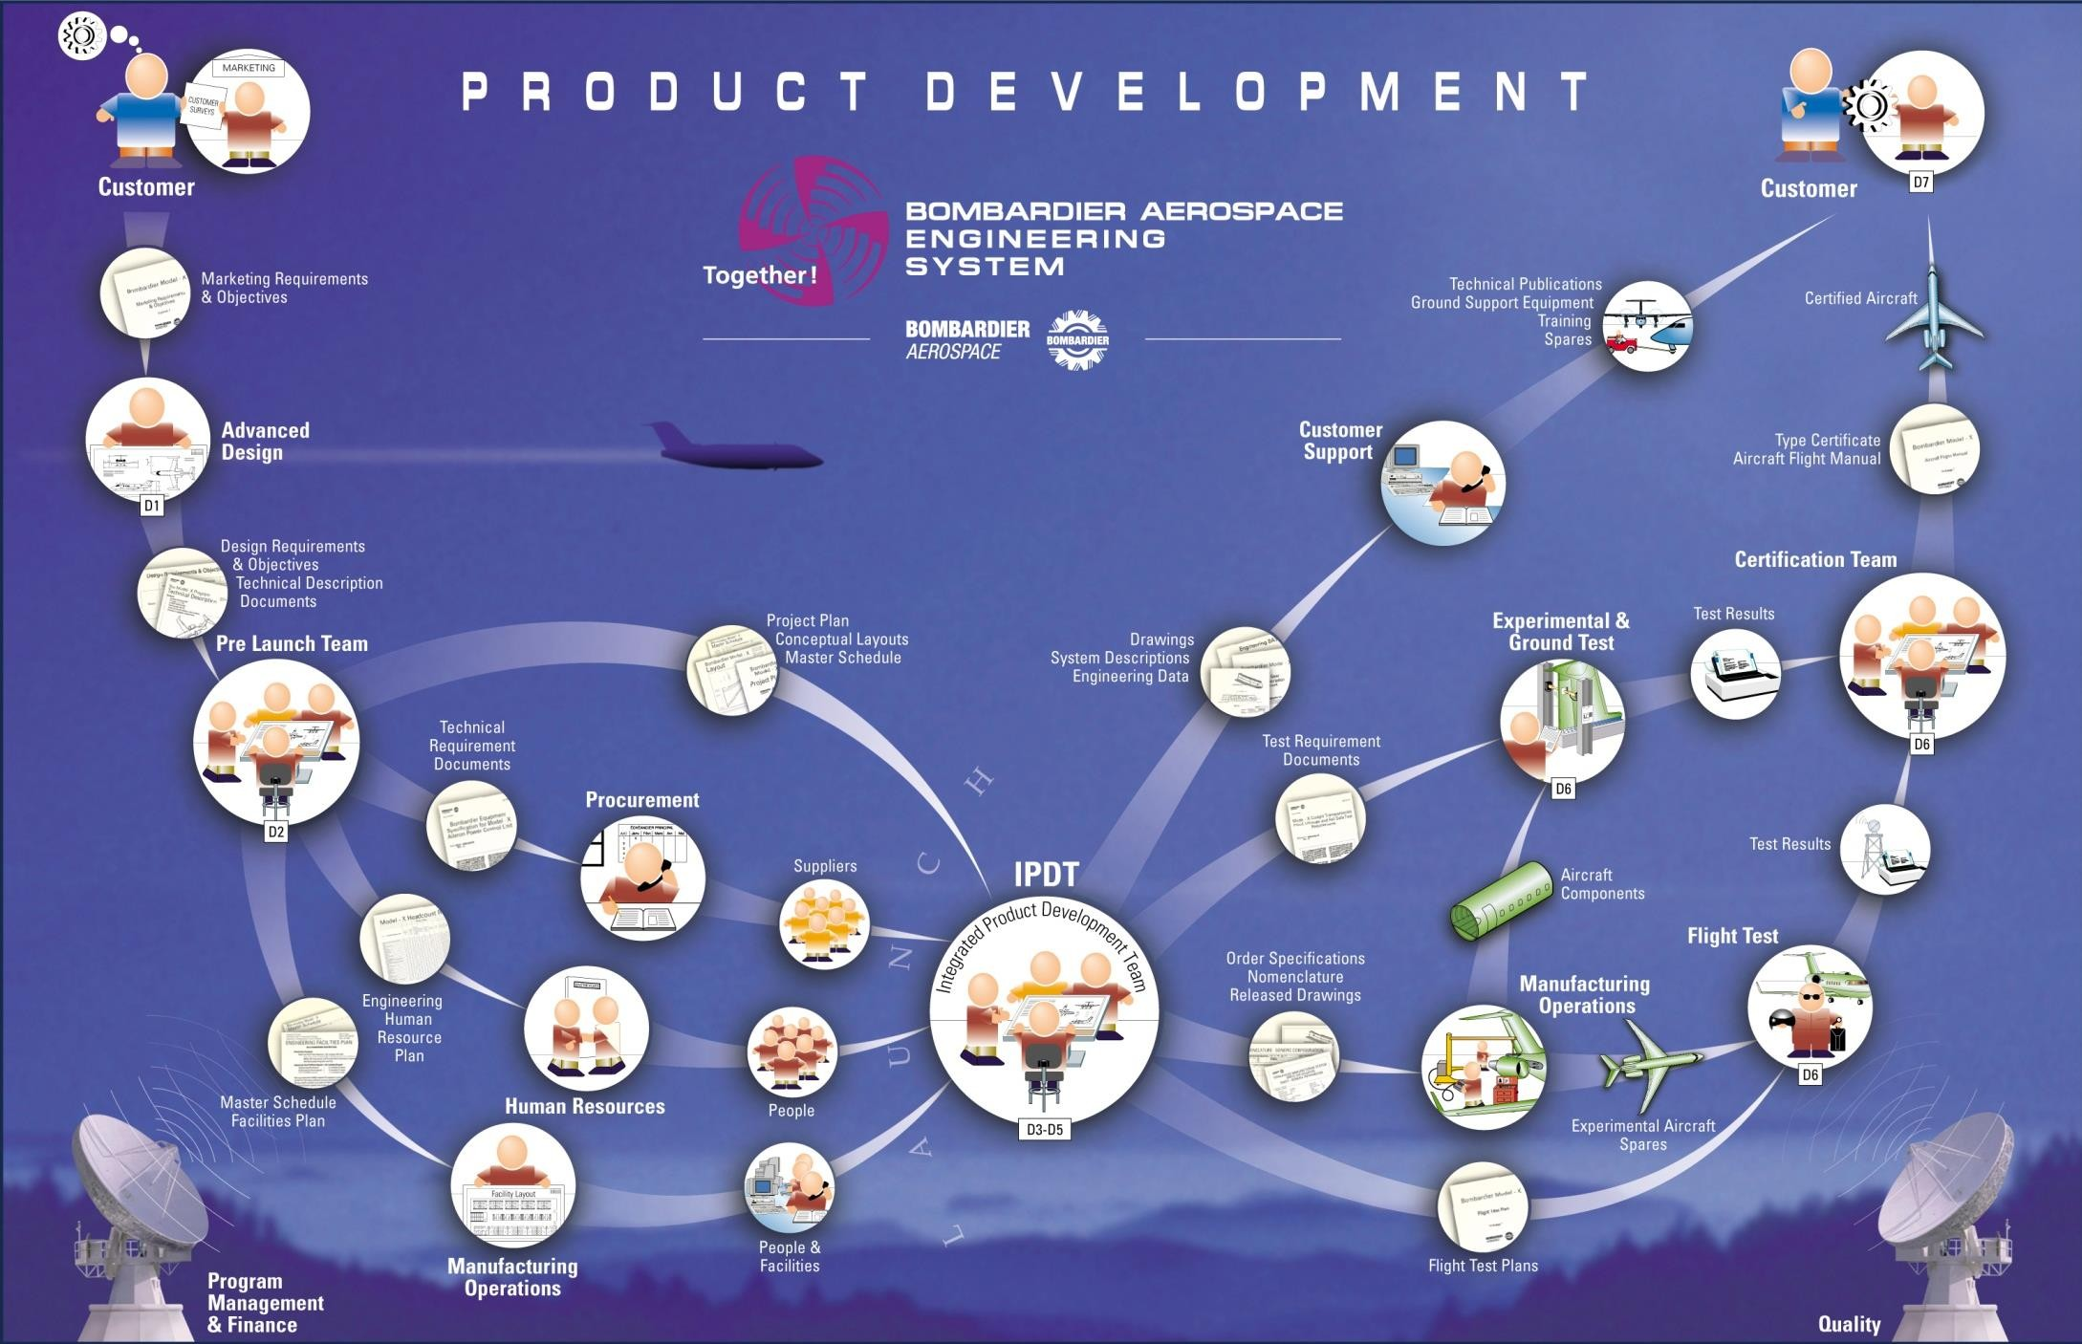
Bombardier Aerospace Engineering System

Slide 7
BES Key Elements
Phase - A significant planned segment of a program
Milestone - A planned event at a specific point in the program, that provides an opportunity to check progress, evaluate plans, and make go/no go decisions
Process - Diagram of customer and supplier relationship with a sequence of activities/tasks to produce a deliverable for a particular process
Function - Expertise within a discipline led by Core Function Champion[s]
and represented at all Business Unit programs by Business Unit Experts
Deliverable - Tangible data or document required by a Customer (internal or external), used to monitor progress, and adds value to the process
Data Item Description (DID) - A document that describes a deliverable’s purpose, content, and format
Practice - Documentation that provides operational policy, deliverable preparation instruction, and repository of knowledge (design guideline, guiding principle, and best practice)

Slide 8
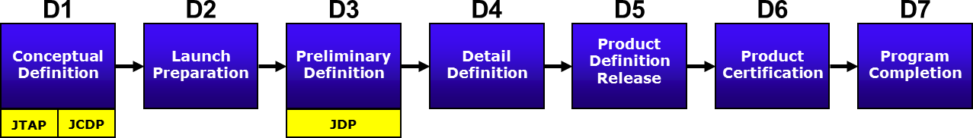
BES Phase
An aircraft program progresses through seven distinct prescribed phases
New Product Development Program
Sustaining Program Product Improvement
Defined as a significant planned segment of a program
Each phase is considered independent
JTAP: Joint Technical Assessment Phase JCDP: Joint Conceptual Definition Phase JDP: Joint Definition Phase
“DDP”: D4
“PDRP”: D5
“PCP”: D6

Slide 9












BES Milestone (with respect to Phase)
A planned event at a specific point (not necessarily a specific point in time) in a program
An opportunity to check progress and evaluate plans (Management Decision to proceed)
Type
Specification Review
D1.10
Launch Review
D2.10
Preliminary Definition Exit Review
D3.10
Critical Design Review
D4.10
Production Design Freeze
D5.10
Certificate Readiness Review
D6.10
Operation Validation Review
D7.10
D1
D2
D3
D4
D5
D6
D7
Conceptual Definition
JTAP | JCDP
Launch Preparation
Detail Definition
Product Definition Release
Product Certification
Program Completion
Preliminary Definition
JDP
D1.05
Feasibility Study Review
D2.05
Authorization to Offer
D3.05
Preliminary Design Review
D6.05
First Flight Readiness Review
D7.05
Entry Into Service
“ATO”: D2.05, “PDR”: D3.05, “CDR”: D4.10, “FFR”: D6.05, “EIS”: D7.05

Slide 10
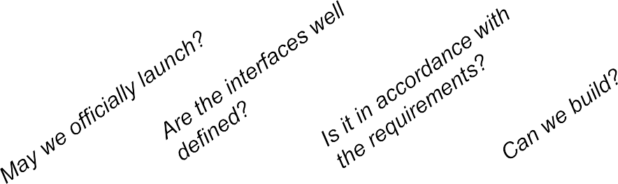













BES Milestone - Quick Summary
Preliminary Definition Exit Review
D3.10
Critical Design Review
D4.10
Production Design Freeze
D5.10
Type Certificate Readiness Review
D6.10
Operation Validation Review
D7.10
Specification Review
D1.10
Launch
Review
D2.10
D1
D2
D3
D4
D5
D6
D7
Conceptual Definition
JTAP | JCDP
Launch Preparation
Detail Definition
Product Definition Release
Product Certification
Program Completion
Preliminary Definition
JDP
D1.05
Feasibility Study Review
D2.05
Authorization to Offer
D3.05
Preliminary Design Review
D6.05
First Flight Readiness Review
D7.05
Entry Into Service

Slide 11
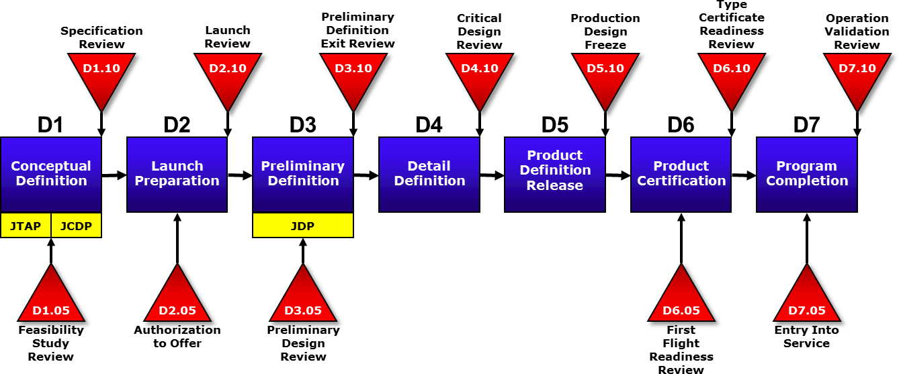
BES Phases Duration (Approx.)
12-36 mo.
12 mo.
12-24 mo.
24-36 mo.

Slide 12




Aircraft Life Stages
Development
Sustaining
Legacy
D1
D6
Out of Production
End of Life
Type Cert.
The Bathtub Curve
Increased Failure Rate
Early “Infant Mortalities” Failures Decreasing Failure Rate
End of life wear-out Increasing Failure Rate
Time

Slide 13
BES Key Elements
Phase - A significant planned segment of a program
Milestone - A planned event at a specific point in the program, that provides an
opportunity to check progress, evaluate plans, and make go/no go decisions
Process - Diagram of customer and supplier relationship with a sequence of activities/tasks to produce a deliverable for a particular process
Function - Expertise within a discipline led by Core Function Champion[s] and represented at all Business Unit programs by Business Unit Experts
Deliverable - Tangible data or document required by a Customer (internal or external), used to monitor progress, and adds value to the process
Data Item Description (DID) - A document that describes a deliverable’s purpose, content, and format
Practice - Documentation that provides operational policy, deliverable preparation instruction, and repository of knowledge (design guideline, guiding principle, and best practice)

Slide 14







Tier 1 - Business Process
Context diagram that defines the boundaries of the six major processes with the phases and milestones
Type
Specification Review
Launch Review
Preliminary Definition Exit Review
Critical Design Review
Production Design Freeze
Certificate Readiness Review
Operation Validation Review
D1.10
D2.10
D3.10
D4.10
D5.10
D6.10
D7.10
D1
D2
D3
D4
D5
D6
D7
Conceptual Definition | Launch Preparation | Preliminary Definition | Detail Definition | Product Definition Release | Product Certification | Program Completion
D1.05
Feasibility Study Review
D2.05
Authorization to Offer
D3.05
Preliminary Design Review
D6.05
First Flight Readiness Review
D7.05
Entry Into Service
P0 - Manage the Program & Project
P1 - Develop Conceptual Definition
P2 - Develop Preliminary Definition
P3 - Produce Product Definition
P4 - Conduct Product Verification
P5 - Support Product Development

Slide 15
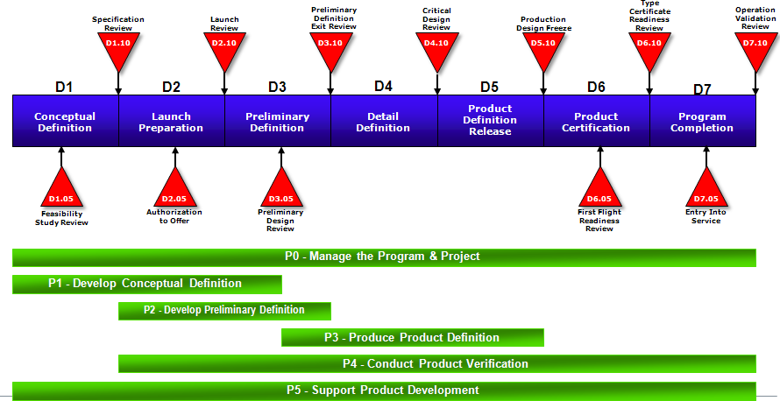
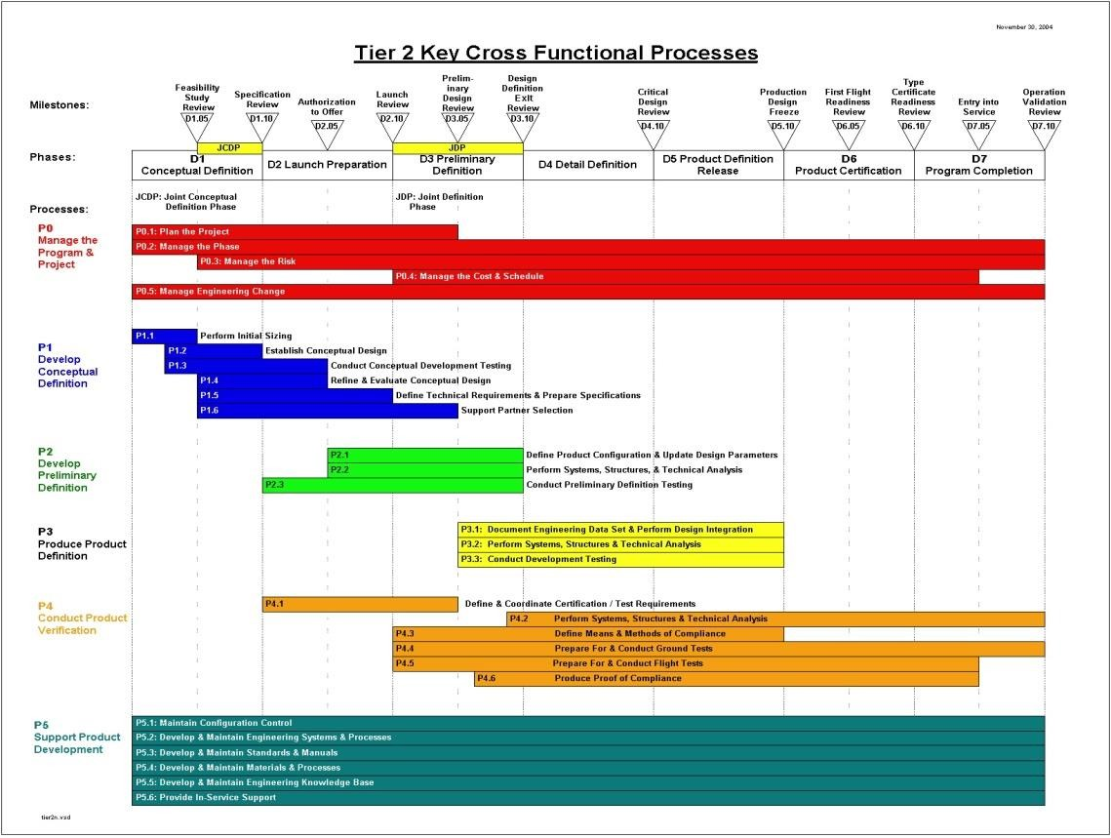
Tier 2 - Cross Functional Process
Expansion of the 6 major business processes into 29 high level cross-functional
processes

Slide 16
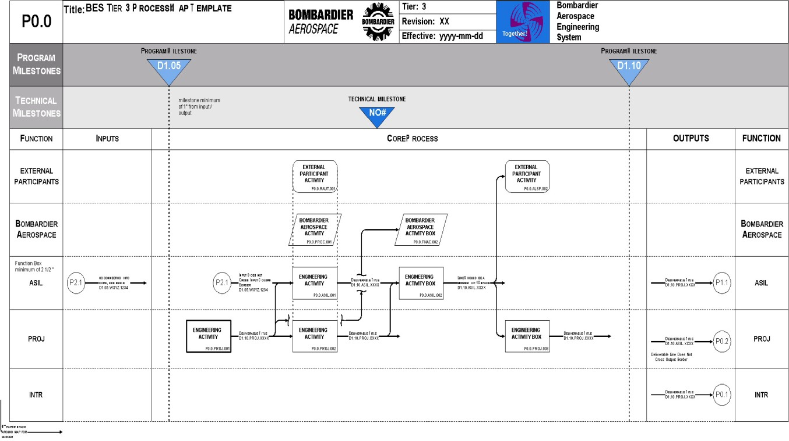
Tier 3 - Functional Activity
Detailed diagram of each of the 29 Tier 2 Cross-Functional processes
Provide high level “supplier” (input) and “customer” (output) relationship
Provide Program / Project management planning by indication of the sequence of Functional Deliverables

Slide 17
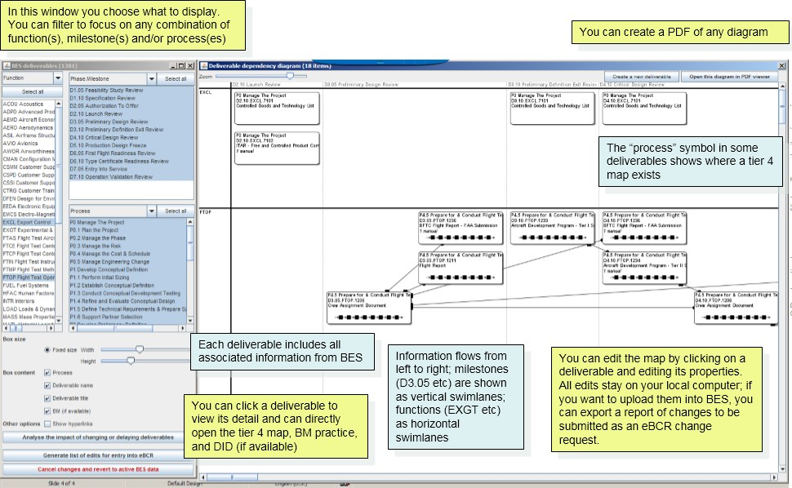
Tier 3 - Functional Activity (Process-Mapping on Demand)
The Process-Mapping on Demand tool displays process maps based on the selected
criteria.

Slide 18
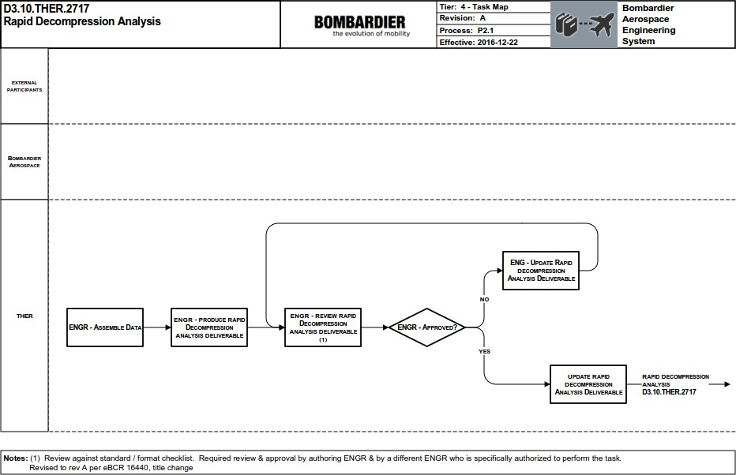
Tier 4 - Functional Task
Provides a series of tasks performed by an individual for the preparation of a single
Functional deliverable from the Tier 3 - Functional Activities processes
Linked to a practice or procedure and the Function’s role and responsibility

Slide 19
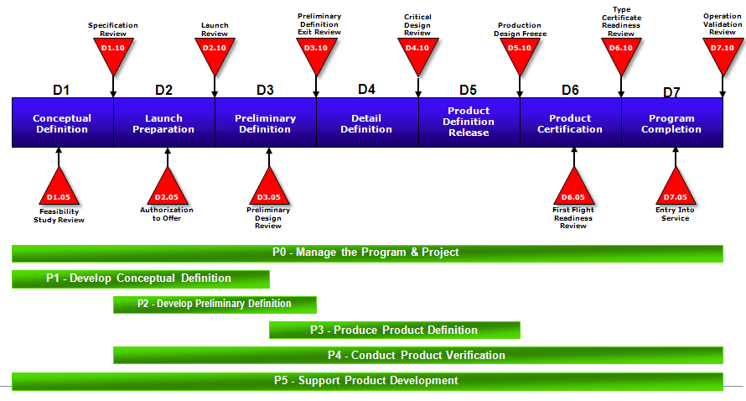

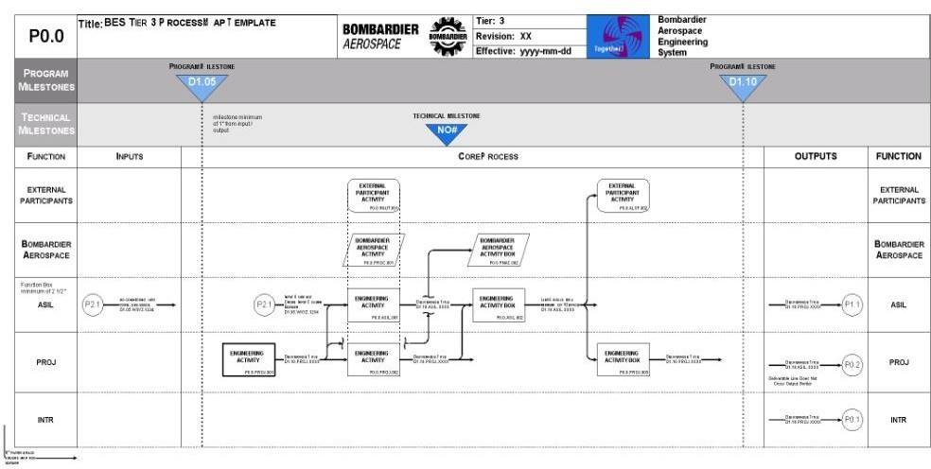
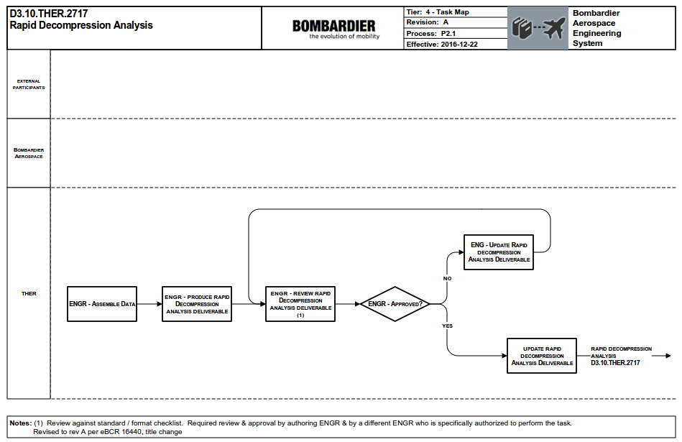
Process Map Interrelationship
TIER 1
TIER 2
TIER 3
TIER 4

Slide 20
BES Key Elements
Phase - A significant planned segment of a program
Milestone - A planned event at a specific point in the program, that provides an
opportunity to check progress, evaluate plans, and make go/no go decisions
Process - Diagram of customer and supplier relationship with a sequence of activities/tasks to produce a deliverable for a particular process
Function - Expertise within a discipline led by Core Function Champion[s] and represented at all Business Unit programs by Business Unit Experts
Deliverable - Tangible data or document required by a Customer (internal or external), used to monitor progress, and adds value to the process
Data Item Description (DID) - A document that describes a deliverable’s purpose, content, and format
Practice - Documentation that provides operational policy, deliverable preparation instruction, and repository of knowledge (design guideline, guiding principle, and best practice)

Slide 21
Engineering Functions (~40)
Expertise within a discipline led by Core Functional Champion[s] and represented at all Business Unit programs by Business Unit Experts
ACOU
APDP
AERO
ASIL
AVIO
AWOR
CMAN
ELEC
EMCS
EXGT
FLTC
FTAS
FTCE
FTCP
FTIN
FTOP
FUEL
HFAC
HYDR
Acoustics
Advanced Product Development Aerodynamics / Flight Performance
Airframe, Structural, System, Installation, and Engineering Liaison
Avionics Airworthiness
Configuration Management Electrical
Electro-Magnetic Compatibility
INTR
LDGM
LOAD
MTLP
NOME
PNEU
PPLT
PROJ
QUAL
RMAS
SENG
SSIM
STDS
STRE
SWAR
SYST
THER
MASS
WIRE
Interiors
Landing Gear / Mechanical
Loads and Dynamics
Materials and Processes Nomenclature Pneumatics
Power Plant
Project Planning and Control Quality Assurance
Reliability, Maintainability, and Safety Service Engineering
System Simulation Engineering Standards Stress and Fatigue
Software Certification Systems Thermodynamics Mass Properties Wire Harness
Experimental and Ground Test
Flight Controls
Flight Test Aircraft Support Flight Test Center Engineering Flight Test Center Project Flight Test Instrumentation Flight Test Operations
Fuel
Human Factors Hydraulics
4-letter Acronyms
Note: BES has about 30 non-engineering functions (e.g. Customer Support, Supply Chain, Operations, etc.) for DIDs to support Programs

Slide 22
BES Key Elements
Phase - A significant planned segment of a program
Milestone - A planned event at a specific point in the program, that provides an
opportunity to check progress, evaluate plans, and make go/no go decisions
Process - Diagram of customer and supplier relationship with a sequence of activities/tasks to produce a deliverable for a particular process
Function - Expertise within a discipline led by Core Function Champion[s] and represented at all Business Unit programs by Business Unit Experts
Deliverable - Tangible data or document required by a Customer (internal or external), used to monitor progress, and adds value to the process
Data Item Description (DID) - A document that describes a deliverable’s purpose, content, and format
Practice - Documentation that provides operational policy, deliverable preparation instruction, and repository of knowledge (design guideline, guiding principle, and best practice)

Slide 23

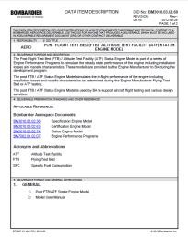





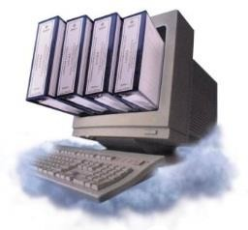
Interdependent Relationship between Deliverables, Data Item Descriptions and BM Practices
Deliverable is tangible document or data “WHAT” that can be passed on to a customer defined by phase/milestone “WHEN” and by “WHO”. Deliverables are mapped on Tier 3 process maps that illustrated the Input – Output relationship
Data Item Description (DID) describes the “WHAT” and provides use or purpose, format,
and content.
The DID points to a process and BM Practice for detailed instructions
D2.10.CMAN.0502
Configuration Management Plan
DID
Process is a graphical representation of “WHO” with a sequence of events, activities and tasks “HOW” to produce a deliverable “WHAT” by a specific milestone “WHEN”.
BM Practice provides detailed preparation instructions for “HOW” and “WHO”
DELIVERABLE
BM PRACTICE
BM Series is a repository of knowledge
PROCESS

Slide 24



Deliverables
SIPOC: Supplier, Input, Process, Output, Customer
DEL
PROCESS DELIVERABLE
From Supplier (Input)
Deliverable Title Deliverable Number
To Customer (Output)
D2.10.CMAN.0502
Functional Identifier* Function
Phase & Milestone
*Note: The first 2 digits of the Functional Identifier corresponds to a BES Function (e.g. AWOR = 04, CMAN = 05, SYST = 26, FTCE = 31)

Slide 25
Data Item Descriptions (DID)
DID
The DID describes the “WHAT”
Provides use or purpose, format, and content
DID provides:
Identification of Functional ownership
Identification of the deliverable title
Definition of the preparation standard or other documents that support or complete the preparation instructions of the deliverable
Definition of the requirements for the format or other considerations
Instructions that define the technical content / considerations that shall be mandatory for the final deliverable
All DIDs are contained in BM3010.03
DID Nomenclature: BM3010.03.XX.XX
Last 4 digits match the deliverable (e.g. BM3010.03.05.02 describes D2.10.CMAN.05.02)

Slide 26
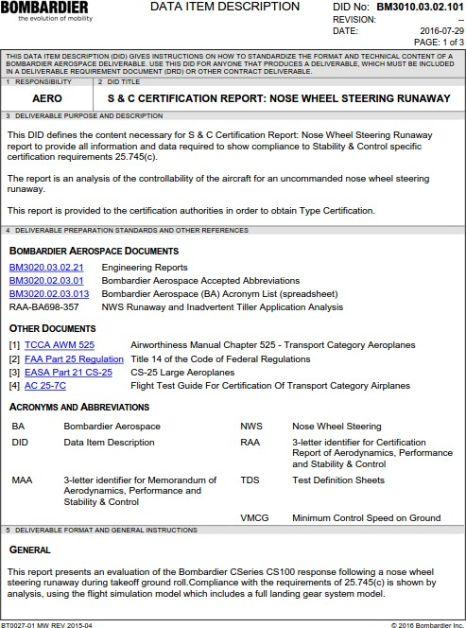
Data Item Descriptions (DID) (continued)
DID

Slide 27
BM Practice and Procedures
BM
BM practices and procedures are contained in the Bombardier Manuals (BM)
Provides detailed preparation instructions for “HOW”
BM Practice provides:
Purpose
Step-by-step preparation instructions
References to Functional policy, support documentation, and regulations
Completed examples of forms and templates
Bombardier Manuals are a repository of design knowledge and best practices
BM Champions are responsible for the material available within their respective volume(s)

Slide 28
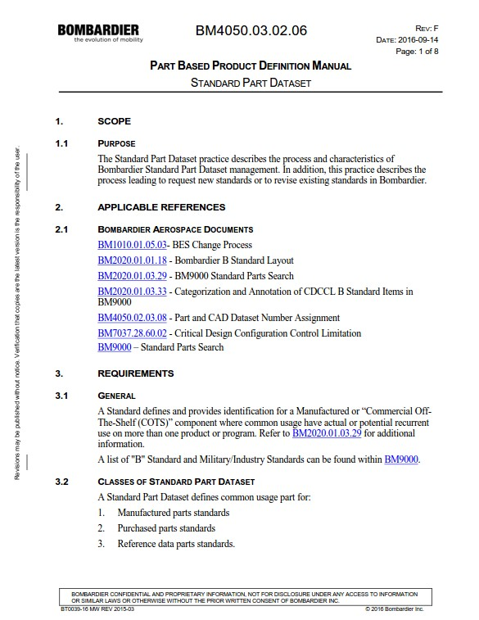
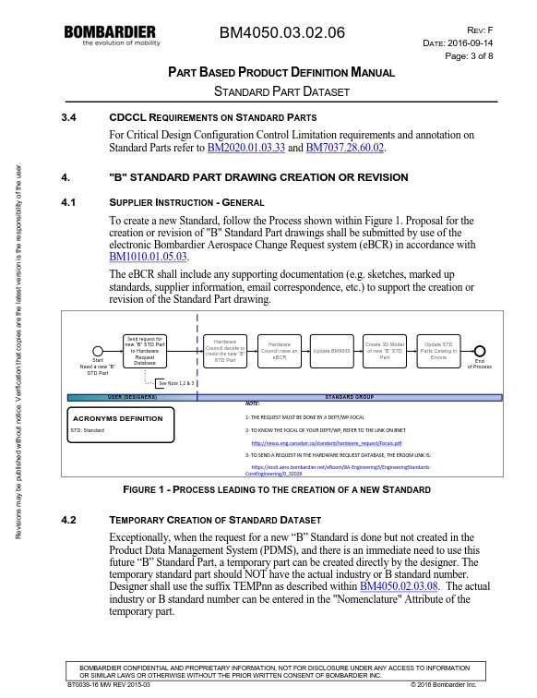
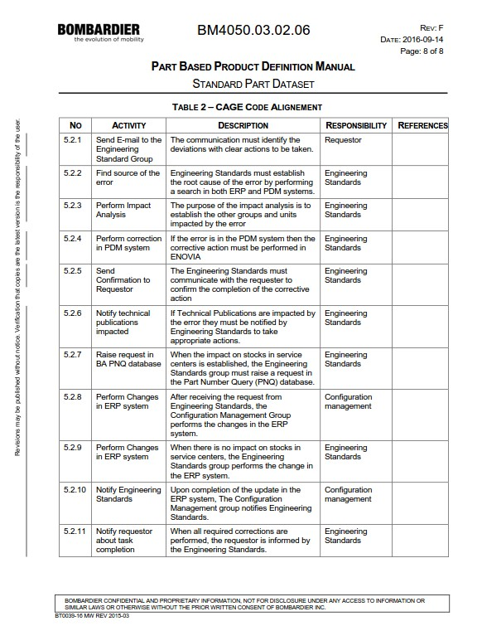
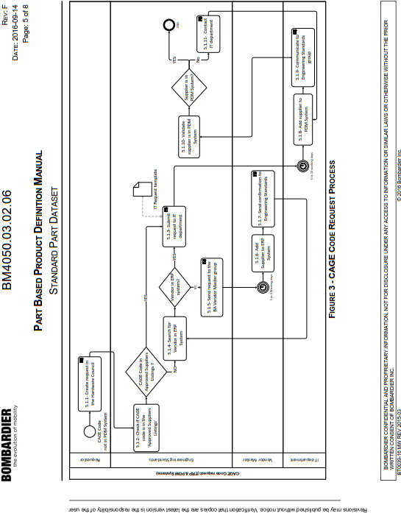
BM Practice and Procedures (continued)
BM

Slide 29

BM Practice Structure
BM40 – Manual
BM4050 – Volume*
BM4050.01 – Chapter
BM4050.01.01 – Section
BM4050.01.01.01 – Practice
BM
*Note: BM Champions are responsible at the Volume level

Slide 30


BES Key Elements
(as of May-2019)
7 Phases
Phase: A significant planned segment of a program
12 Milestones
Milestone: A planned event at a specific point in the program, that provides an opportunity to check progress, evaluate plans, and make go/no go decisions
1576 Deliverables
Deliverable: Tangible data or document required by a Customer (internal or external), used to monitor progress, and adds value to the process
1022 DIDs
Data Item Description (DID): A document that describes
a deliverable’s purpose, content, and format
68 Functions & BES Champions
Function: Expertise within a discipline led by Core Function Champion[s] and represented at all Business Unit programs by Business Unit Experts
244 BU Experts
Business Unit Experts in Amphibious, CSeries Belfast, Challenger, CRJ, Dash 8, Global, Global 7000/8000, GCC, Learjet, Learjet 85 and Plant1
2496 BM Practices and
1294 Specifications
Practice: Documentation that provides operational policy, deliverable preparation instruction, and repository of knowledge (design guideline, guiding principle, and best practice)
751 Forms and Templates
Forms and Templates: pre-developed page layout in electronic media to produce statements, requests or orders.
648 Tier 4 Process Maps
Process: Diagram of customer and supplier relationship with a sequence of activities/tasks to produce a deliverable for a particular process

Slide 31
Accessing BES Portal
Bnet → Communities → Engineering → BES
The BES Portlet page
is the most hit, work-related page on Bnet.

Slide 32
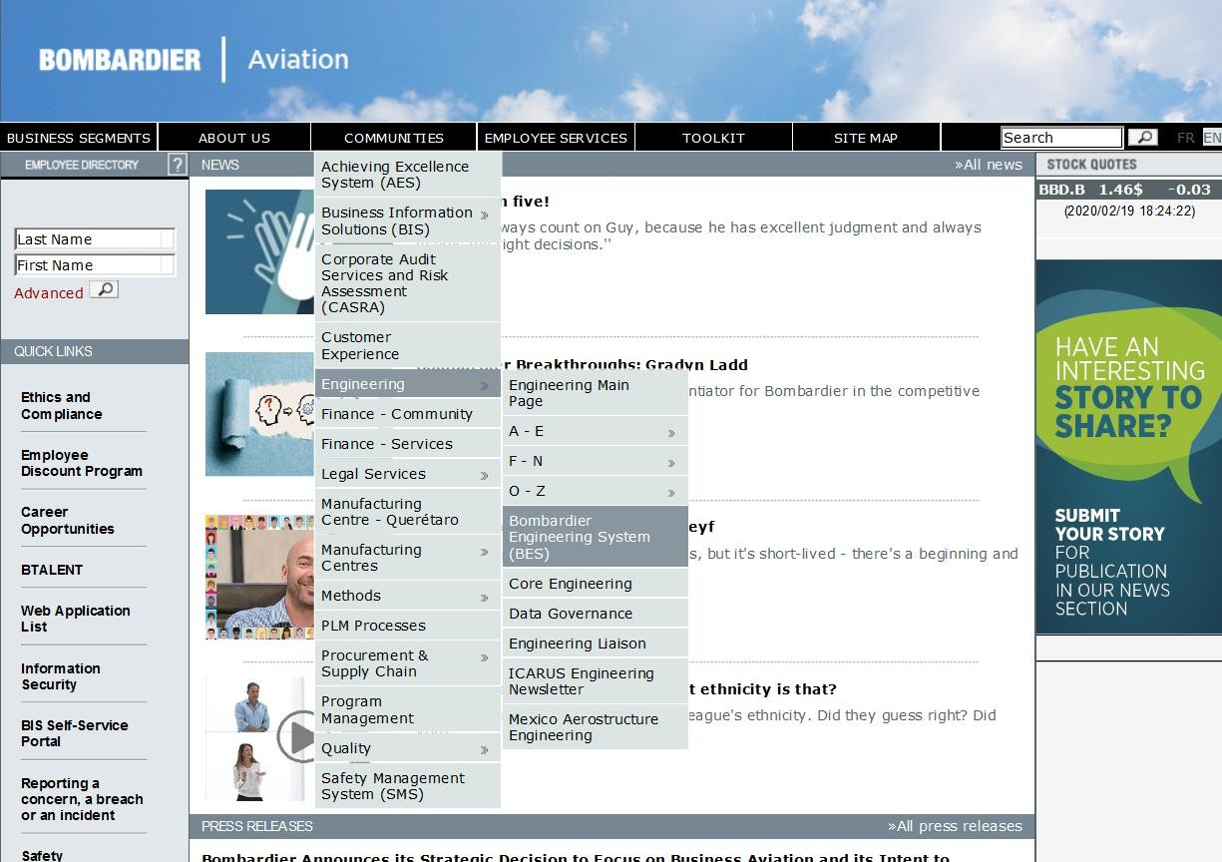
On-line demo

Slide 33
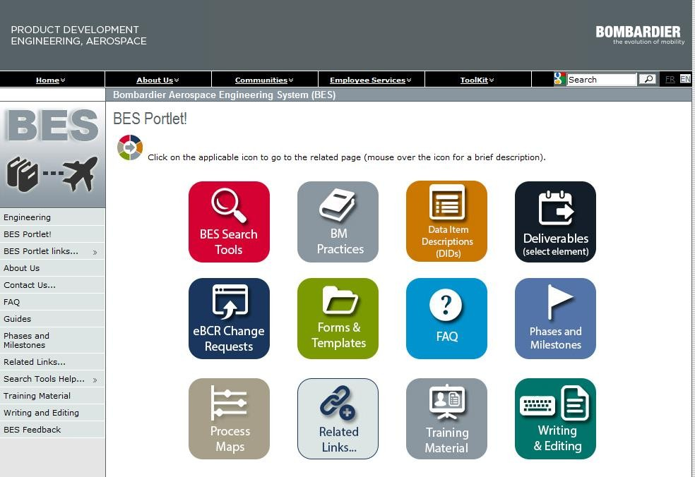
eBCR – electronic BES Change Requests
All changes to BES material (Practices, DIDs, Deliverables, Boilerplates, Templates) MUST go through an eBCR
NO eBCR, NO change/publishing.
Publish material to two locations:
Bnet
Bombardier.com for suppliers
Access to the eBCR is from the BES Portal Page…
eBCR access

Slide 34
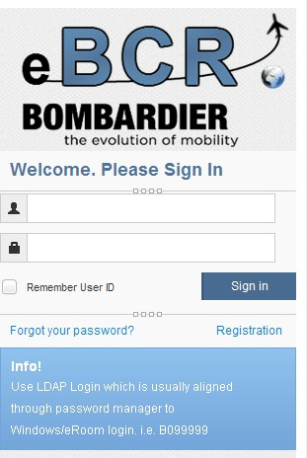
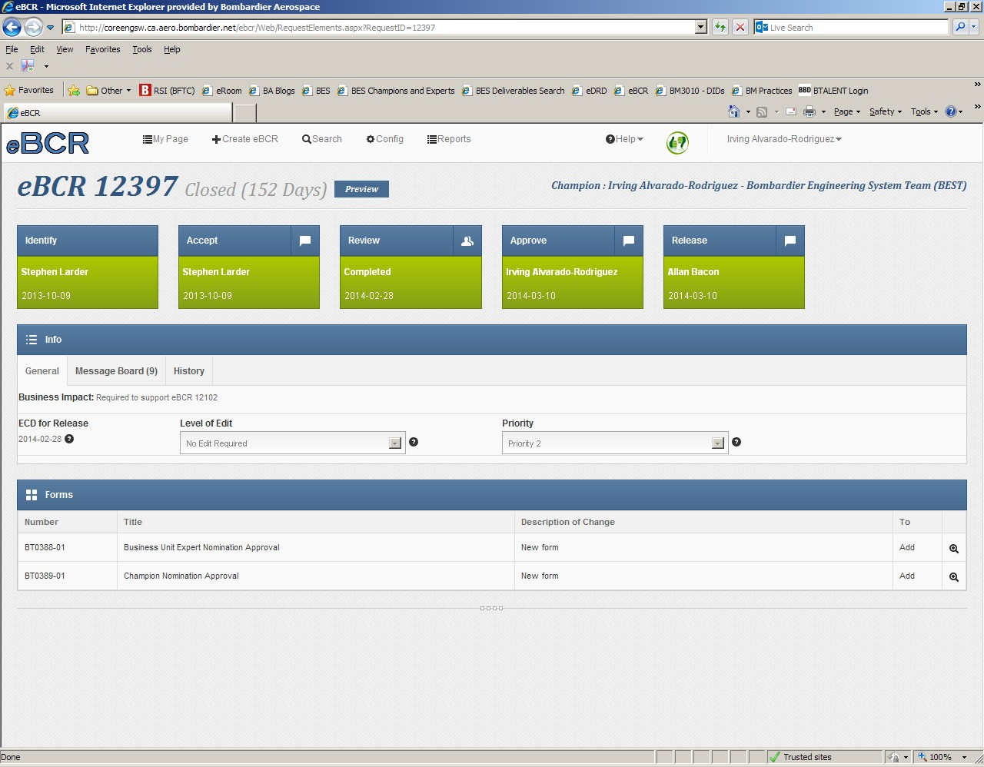
eBCR Home page

Slide 35








Exceptional by design
PRIVATE AND CONFIDENTIAL. © Bombardier Inc. or its subsidiaries. All rights reserved.

